Slide 1
MICRO TIG WELDING MACHINE AT ARCRAFT PLASMA

Slide 2
Arcraft Plasma Equipments manufactures , supplies and export Micro TIG Welding Machines.
Micro TIG Welding uses a non Consumable tungsten electrode to produce the arc.
Our specially designed circuit enables the machine to work reliably using helium or argon as the shielding gas.
Complete automation for linear and circumferential welding jobs is provided as per the requirement.
ARCRAFT PLASMA

Slide 3
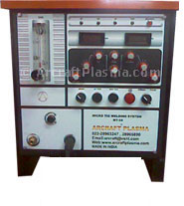
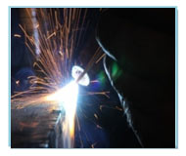
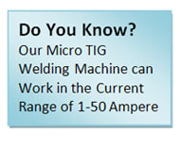
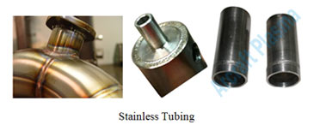
ARCRAFT PLASMA

Slide 4
FEATURES
IGBT inverter based power source.
Integrated High Frequency starter system.
Close loop system for highly stable arc even at low current.
Ultra fast recovery design for fast correction of weld parameters to accommodate change in arc length and input supply variation.
PLC sequencer for automatic operation and integration with external interfaces like Welding lathe, Positioner, Turntable, Linear, Welding fixture.
Digital technology with 99 program facility.
ARCRAFT PLASMA

Slide 5
APPLICATIONS
Mould and die repairs.
Aero space components.
Laboratory equipments.
Medical devices.
Automotive components.
Electronic components.
General industrial components.
ARCRAFT PLASMA

Slide 6
THANK YOU ARCRAFT PLASMA EQUIPMENTS PVT. LTD. Address : 124, Diamond Industrial Estate, Ketkipada, Dahisar (East), Mumbai- 68. Ph : 0091-22-28965890/5745/3247. Fax: 00-91-22-28966418 . email : arcraftplasma@gmail.com Website : www.arcraftplasma.com

