Slide 1
Welding Automation
Enhance Working Environment

Slide 2

Our Mission
“ Our commitment is to provide reliable, cost-effective and most advanced quality Automation system.
We offer the most comprehensive welding engineering and consulting services with efficiency & precision. ”

Slide 3
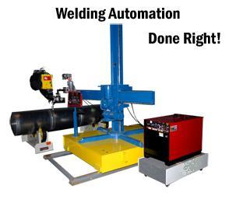
Automation Equipments
Arcraft automates welding system to help you increase welding quality, improve welding productivity, enhance working environment and decrease manufacturing cost.
Following are our automation equipments:
    Welding Oscillator
    Welding Positioner
    Welding & Cutting Gun
    Column and Boom
    Cross Slides
    Welding Lathe
    Welding Turntable
    Cold Wire Feeder
    Seam Tracker
    Tank Rotator

Slide 4
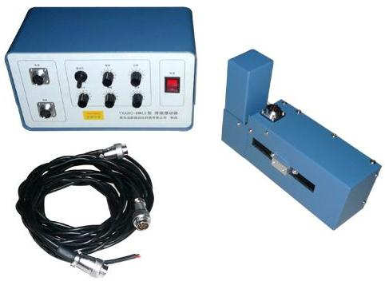
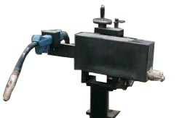
Welding Oscillator
Weld Arc Weaver; commonly known as Welding Oscillator is a mechanism to simulate the condition of Weld Arc Weaving as done by hand by an expert welder.
Features
  Very precise Ball screw mechanism
  Fully enclosed to avoid ingress of fine particles, heat, etc.
  Stepper motor driven for easy controllability
  Stroke width of 0 to 50 mm (Higher width available on request)
Key Advantages
  Significant improvement in Welding or Cladding process.
  Increased productivity with ease of operation for Multi-pass welding.
  Overall improvement in sidewall fusion & undercut.

Slide 5
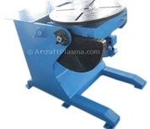
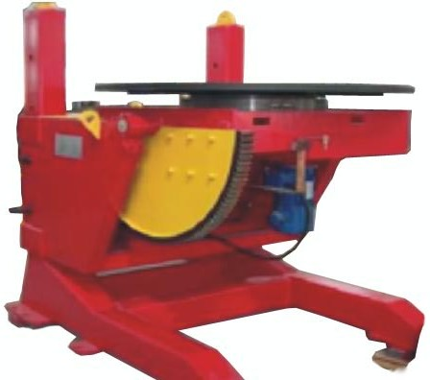
Welding Positioner
Positioners provide a versatile and productive means for placing bulky fabrication jobs in the ‘down-hand’ position
This reduces handling time and frequent use of crane
Conventional Welding Positioner
The positioners tables rotate at accurate and constant variable speeds and tilt through 135° with a high C.G. load rating and can be conveniently used for circumferential welding, saw and strip cladding
Height Adjustable Positioner

Slide 6
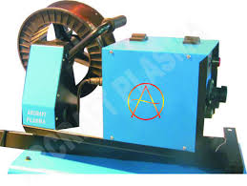
Cold Wire Feeder
The Cold Wire Feeder works independently for TIG welding system with normal TIG parameters.
Features
  Precise and Controlled work
  Duplicate Elimination
  Dual Groove Drive Roll
  Eliminates Stub Loss
  Automatic
  High Quality Weld

Slide 7
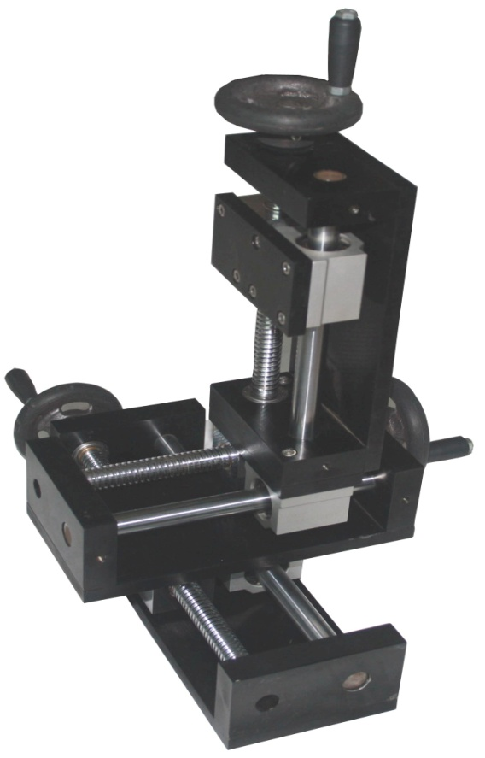
Cross Slide
Cross Slide provide fine precise movements for adjusting of the welding heads in automated welding systems.
Features
  The slides are available in various capacities from small size (4 Kg ) to big size (70 Kg)
  They can be fitted to give 1, 2 or 3 axis moment.
  The slides provide precise back lash free movements
  Accessories for welding head fitting like torch mounting clip, spinning flange, tilting arrangement and the setting up flange are available.

Slide 8
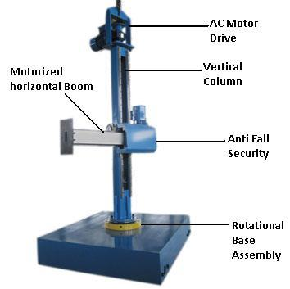
Column & Boom
We are pleased to provide our Welding Column and Boom to automate your welding work.
Features
  In Light Duty Models (up to 3meter * 3meter), the vertical movement is through Lead Screw.
  In Medium & Heavy Duty Boom, the vertical movement is through Rack & Pinion with counter weight arrangement for 'Fail Safe' anti-fall mechanisms in all models.
  Provision of anti-fall security.

Slide 9
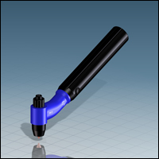
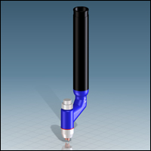
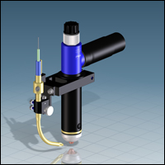
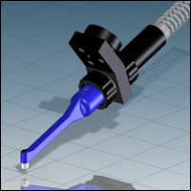
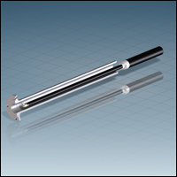
Welding & Cutting Gun
Available for cutting metals and non-metals of thickness 10mm to 150mm
Heat Resistant
Extruded rubber jacket, Abrasion-resistant.
Guns are available that are light and easy to use, either hand held or machine mounted
Suitable for welding process like:
  TIG
  MIG / MAG / FCAW
  Plasma welding
  SAW
  PTA
  Strip Cladding

Slide 10
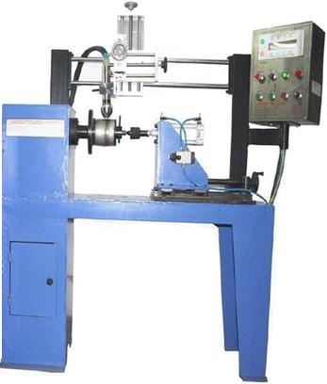
Welding Lathe
Arcraft Plasma’s Welding Lathe has been innovatively engineered to provide a versatile platform for high production circumferential welding
Accurate motorized Spindle with through bore 2.85” diameter
A/C Geared motor driven Headstock with 0.5 to 5 rpm speed range ( higher or lower speeds available on request )
Precision fabricated MS lathe bed
12” (305 mm) diameter part swing. Larger capacity available on request
18” (455mm) part length capacity

Slide 11
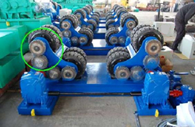
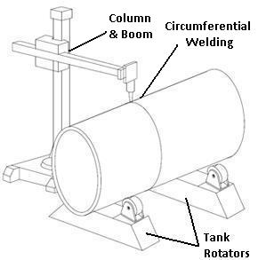
Welding Rotators
Welding Rotators are probably the most versatile and useful positioning equipment in a fabrication
The machine consists of a Drive unit and Idler unit which can be one or more and Control panel with pendant.
AC geared motors with variable frequency drive is used for stepless speed variation.
Tank Rotators are probably the most versatile and useful positioning equipment in a fabrication shops.
They are mainly used to rotate or position the cylindrical jobs for circumferential welding (TIG / MIG / Sub Arc).

Slide 12
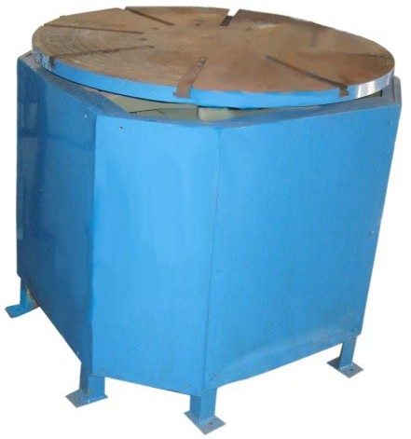
Welding Turntable
We manufacture custom built models as per customer’s requirements.
Features
  Heavy Duty construction
  AC geared motors with VFD ensures smooth and steady rotation rates
  Rotation speeds are infinitely variable in both forward and reverse directions
  Encoder mounting facility available for automation needs
  Options available for hands free operation

Slide 13
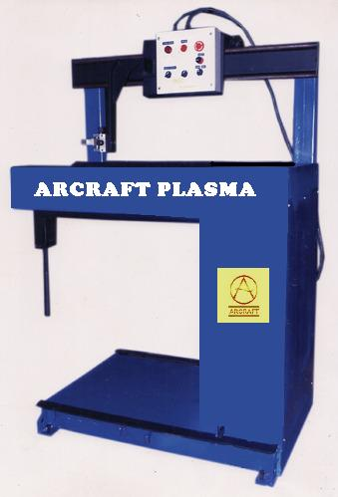
Seam Tracker
Weld Seam Tracking as the name suggests is an automated system which tracks & compensates irregularities in the weld seam and also tracks moving joint profiles during welding process.
Features
  Precise Weld Joints
  Wide Application: Suitable for processes like TIG, Plasma, MIG, Sub-Arc, Strip cladding
  Programmable: Programmable to store various programs
  Heavy Duty Cross Slides
  Rugged
  Ease of Operation
  Suitable to use for I or H beam or structural fabrication
  Multiple Axis

Slide 14
Thank You
Arcraft Plasma Equipments ( I ) Pvt. Ltd.
124, Diamond Industrial Estate,
Ketkipada, Near Dahisar
Check Naka,
Dahisar-E,
Mumbai – 400 068
India
Contact Us : +91 022 28965890, 28965745, 28963247
email : arcraftplasma@gmail.com, arcraft@vsnl.com
www.arcraftplasma.com, www.plasmaweldings.com

