Slide 1
PLASMA TRANSFERRED ARC WELDING (PTAW) AT ARCRAFT PLASMA

Slide 2
Arcraft is the name to turn to for innovative technology.
With Plasma Transferred Arc Welding we provide high productivity, high quality of powder deposits and significantly lower cost for hardfacing even in the most challenging area such as valves, valves seat of internal combustion engine, accessories for ship, petroleum and power generation.
PTA is also used for reclamation of worn jobs extending the life of components and giving a huge savings on cost.
Argon is basically used for arc plasma supply, powder transport and molten material shielding. It produces a very high quality deposit offering optimal protection with minimal dilution or deformation of the base material.
ARCRAFT PLASMA

Slide 3
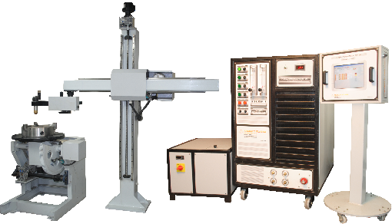
ARCRAFT PLASMA

Slide 4
FEATURES
CNC based fully automatic operation.
12” TFT LCD Touch-Screen Display.
Pre-Program facility for all parameters like:
-Gas Pre-flow / Post-flow time, Powder flow rate.
-Weld current, Up-slope / Down-slope time.
-Rotation speed, Boom step-over, Number of bands / cycle.
-Oscillation width, Oscillation speed, Dwell time.
Choice of Positioners / Job Manipulator:
-Weight capacity from 100 kg to 2500 kg.
-Face plate diameter from 250 mm to 2000 mm.
Choice of Column & Boom: Stroke length from 500 mm to 2000 mm.
Choice of ID as well as OD Torches.
Suitable for Circular, Straight, Screw, Ball Valve deposits.
ARCRAFT PLASMA

Slide 5
HOW IT WORKS

Slide 6
Plasma Transferred Arc is used for welding at high arc travel speeds.
For initiating a transferred arc, a current limiting resistor is put in the circuit, which permits a flow of about 50 amps, between the nozzle and electrode and a pilot arc is established between the electrode and the nozzle.
As the pilot arc touches the job main current starts flowing between electrode and job, thus igniting the transferred arc.
The pilot arc initiating unit gets disconnected and pilot arc extinguishes as soon as the arc between the electrode and the job is started.
This process provides minimal dilution and high resistance to chipping because of its dense metallurgical structure, free of voids, oxide films, and discontinuities.
Used on parts subject to corrosion, thermal shock, severe abrasion, slurry erosion, or extreme impact forces to increase component life.
ARCRAFT PLASMA

Slide 7
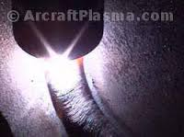
SAMPLES
ARCRAFT PLASMA
ARCRAFT PLASMA
ARCRAFT PLASMA

Slide 8
BENEFITS
Reduces Cost - Restoring a worn part to "as new" condition generally costs between 20-70% of a brand new replacement part.
Prolongs Equipment Life - Service life increases of 3 to 10 times are common with properly overlaid parts.
Reduces Downtime - Parts last longer and fewer shutdowns are required.
Less Spare Parts Inventory - There is no need to keep numerous spare parts when worn parts can be rebuilt.
High Quality Deposit - It produces a very high quality deposit offering optimal protection with minimal dilution or deformation of the base material.
Precise Coating - It is a process that deposits very precise coatings of perfectly controlled alloys on mechanical parts that are subject to intense wear, significantly extending their service life.
Protection - Corrosion, thermal shock and abrasion.
Metal buildup / Reclamation - Certain alloys are made to rebuild a part to a required dimension while others are designed to be a final overlay that protects the work surface.
ARCRAFT PLASMA

Slide 9
APPLICATIONS
Downhole drilling tools.
High wear piping components / slurry transport.
Ground engagement equipment for the oil sands / mining industries.
Extruding machine screws, valves, valve seats of internal combustion engines (motorcar, marine, locomotive etc).
Equipment for mining, crushing, rolling, road building and tunneling.
Areas where traditional wire based overlays such as chromium carbide are not providing significant wear-life.
Moulds and forging dies, Pulp and paper industry equipment, Agricultural equipment.
Parts for nuclear & chemical plants.
ARCRAFT PLASMA

Slide 10
SCOPE OF SUPPLY
Inverter Power Source (Lincoln Electric).
PTA OD Torch Head 350 Amp with 4 mtr Cable.
Water Chiller cum Re-Circulator.
Powder Feeder Positive Displacement.
Digital Oscillator.
Welding Positioner.
Column & Boom.
Controller for Hardfacing System.
Idler.
Consumables. (2- Electrode, 10- Nozzle, 5- Inner cap, 5- Outer cap, 5-Collet, 3- Nozzle Adaptor, 10-O' Ring for Nozzle Adaptor (17.0mm x 2mm), 10-O' Ring for Nozzle Adaptor (26.5mm x 2mm), 10-O' Ring for Torch Body (46mm x 2mm), 2-Collet spanner, 2-Nozzle Adaptor spanner)
ARCRAFT PLASMA

Slide 11
THANK YOU ARCRAFT PLASMA EQUIPMENTS PVT. LTD. Address : 124, Diamond Industrial Estate, Ketkipada, Dahisar (East), Mumbai- 68. Ph : 0091-22-28965890/5745/3247. Fax: 00-91-22-28966418 . email : arcraftplasma@gmail.com Website : www.arcraftplasma.com

