Slide 1

PLASMA CUTTING MACHINES
AT
ARCRAFT PLASMA

Slide 2
We design & manufacture Air/Gas Plasma Cutting Machines which cuts through any ferrous and non-ferrous material.
We supply throughout India & export all over the world.
Our machines are capable to cut materials of up to 150mm(6 inch) thickness.
Automation is available with Portable Trolleys Rail, Profile Cutting Systems and CNC Cutting Systems. Available in 12 different model.
Bevelling and Hole piercing facility available.
ARCRAFT PLASMA

Slide 3
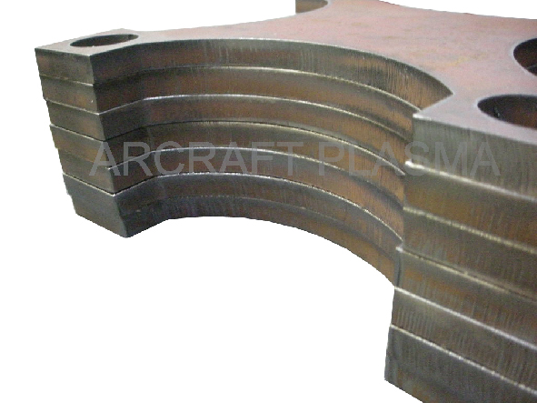
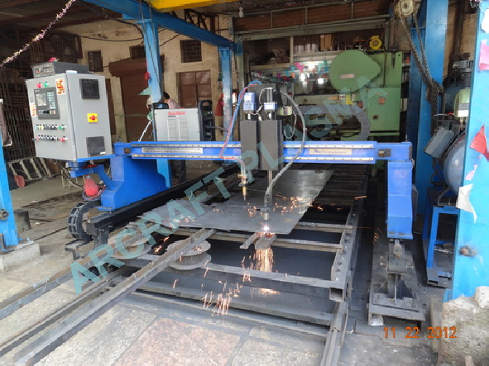
SAMPLE
ACTUAL PROCESS

Slide 4

HOW IT WORKS

Slide 5
Plasma cutting is a process that is used to cut ferrous (stainless steel, cast iron, pig steel, etc.) and non-ferrous metal (aluminum, copper, tool steel, die steel, lead, nickel, tin, titanium and zinc, and alloys such as brass, etc).
In this process, air (for metal of 70mm) and inert gas (for metal 70mm above) is blown at high speed out of a nozzle; at the same time an electrical arc is formed, through that gas from the electrode flows to the surface being cut, turning some of that gas to plasma.
The plasma is then forced through a fine-bore copper nozzle which constricts the arc and the plasma exits the orifice at high velocities (approaching the speed of sound) and a temperature approaching 28,000 °C (50,000 °F) or higher.
In ionized state atoms break into electrons (-) and ions (+) and the system contains a mixture of ions, electrons and highly excited atoms.
ARCRAFT PLASMA

Slide 6
The degree of ionization may be between 1% and upto 100% i.e.; double and triple degrees of ionization.
The energy of the plasma jet and thus the temperature is dependent upon the electrical power employed to create arc plasma.
A typical value of temperature obtained in a plasma jet torch may be of the order of 50,000F against about 10,000F in ordinary electric welding arc.
The plasma is sufficiently hot to melt the metal being cut and moves sufficiently fast to blow molten metal away from the cut.
ARCRAFT PLASMA

Slide 7
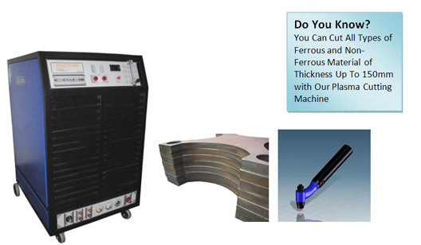
ARCRAFT PLASMA

Slide 8
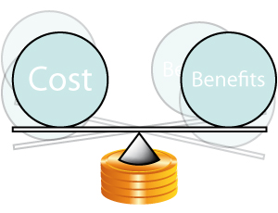
BENEFITS!!

Slide 9
Plasma cutting system arrives ready to go for fast and precise cutting.
IGBT inverter based with analog/digital controls & integrated HF arcing system.
Ultimate Portability.
Low Power Consumption.
Excellent Power Factor.
Easy to Operate.
High Cutting Capacity.
Long Life of Consumables.
Air/Water Cooled Torches.
Smooth Cut.
Extendable Torch Cable.
Powder Coated Chassis & Panel.
ARCRAFT PLASMA

Slide 10
APPLICATIONS
It can cut all electrically conductive metals like S.S, C.S, Copper, Aluminum, Inconel , Titanium, etc.
Cut expanded metal, painted or rusted plates.
Nonlinear cuts and beveling for edge preparation before welding.
Gouging can be performed just by changing the nozzle.
Hand held and mechanized options available.
Air plasma cutting up to 70 mm / Gas plasma cutting up to 150mm.
ARCRAFT PLASMA

Slide 11
SCOPE OF SUPPLY
Power Source.
Hand or Machine Torch with 7 mtr cable.
Earthing Clamp with 7 mtr cable.
Air Filter with Regulator.
Box spanner.
Suitable Trolley for Machine mounting.
Consumable package (5-Electrode, 5-Nozzle, 1-Electrode Holder, 1-Front Cap, 1-Contact Tube).
ARCRAFT PLASMA

Slide 12
THANK YOU
ARCRAFT PLASMA EQUIPMENTS PVT. LTD.
Address : 124, Diamond Industrial Estate,
Ketkipada, Dahisar (East), Mumbai- 68.
Ph : 0091-22-28965890/5745/3247.
Fax: 00-91-22-28966418 . email : arcraftplasma@gmail.com
Website : www.arcraftplasma.com

