Slide 1

MICRO PLASMA WELDING
AT
ARCRAFT PLASMA

Slide 2
As today is the world of Micro and Nano technology, with our Micro Plasma Welding Machine (with current range of 1-50 Amp) you can weld even the thinnest sheets, plates and tubes.
The machine is fully programmable with built in welding cycle timer in the auto mode.
A manual torch and a machine torch are available for manual or mechanized operation.
Complete automation for linear and circumferential welding jobs is provided as per the requirement.
ARCRAFT PLASMA

Slide 3
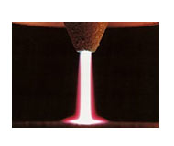
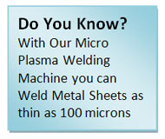
ARCRAFT PLASMA

Slide 4
PROCESS
Micro Plasma Welding Machine has the capability to weld metal sheets of as thin as 100 microns to 3 mm.
It is operated at very low current range of 1 – 50 Amps at 100% duty cycle.
Plasma welding is very similar to TIG as the arc is formed between a pointed tungsten electrode and the work-piece.
However, by positioning the electrode within the body of the torch, the plasma arc can be separated from the shielding gas envelope.
Plasma is then forced through a fine-bore copper nozzle which constricts the arc.
Micro-plasma is traditionally used for welding thin sheets (down to 0.1 mm thickness), and wire and mesh sections, tubes and various delicate assemblies and parts with great precision and reliability.
ARCRAFT PLASMA

Slide 5
FEATURES
With built-in Pilot arcing system.
PLL based closed loop system for highly stable arc.
Full fledged pulsing facility.
Milli second square wave correction technique for fast correction of welding current irrespective of arc length or input voltage variation.
IGBT inverter based with integrated HF start system. PLC sequencer for automatic operation and integration with welding lathe / positioner / turntable / linear welding fixture etc.
A manual torch and a machine torch available for manual or mechanised operation.
The machine is fully programmable ( with built in welding cycle timer) in the auto mode.
Digital version available on demand with complete computer interfacing for welding including turntable for welding round cross sections.
ARCRAFT PLASMA

Slide 6
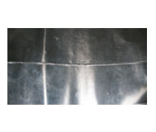

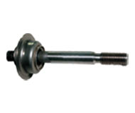

SAMPLES
ARCRAFT PLASMA
ARCRAFT PLASMA
METAL SHEET
SINTERED MEDIA
ARCRAFT PLASMA
ARCRAFT PLASMA
WELDED BELLOW
LONGITUDINAL WELD OF S.S

Slide 7
SCOPE OF SUPPLY
Micro Plasma Torch (25Amp / 50Amp).
Earthing Clamp with 4 mtr Cable
Foot Switch with 4 mtr Cable.
Water Chiller cum Re- circulator.
Consumable Package (3-Electrode, 3-Nozzle, 1-Ceramic Sleeve [Diffuser], 1-Ceramic Cap).
ARCRAFT PLASMA

Slide 8
THANK YOU
ARCRAFT PLASMA EQUIPMENTS PVT. LTD.
Address : 124, Diamond Industrial Estate,
Ketkipada, Dahisar (East), Mumbai- 68.
Ph : 0091-22-28965890/5745/3247.
Fax: 00-91-22-28966418 . email : arcraftplasma@gmail.com
Website : www.arcraftplasma.com

