Slide 1
HARD BANDER MACHINE (HB-610) AT ARCRAFT PLASMA

Slide 2
Hard Banding is a specially designed machine which auto welds hardfacing (wear protection pad) on Drill pipes, Heavy weight drill pipe, Tool joints, Drill collars and other tools used in drilling application including the center wear pads.
Our system offers a complete solution and is fully equipped with latest technology and is ready to weld.
We Design & Manufacture standard and customized machines as per our customer requirements.
We supply throughout India & Export all over the world.
AFT PLASMAARCR

Slide 3
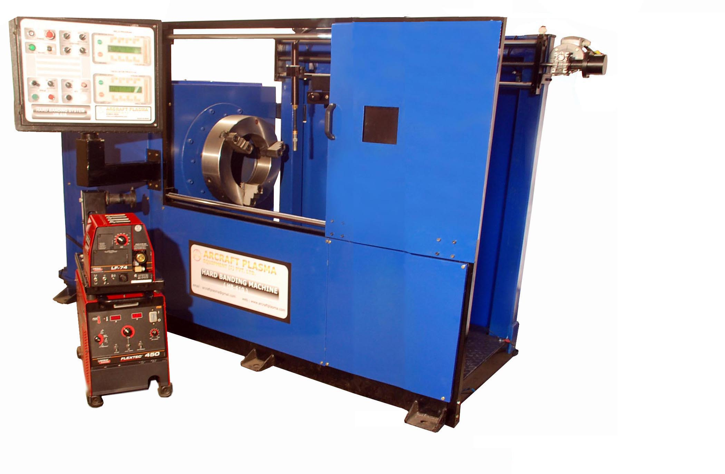
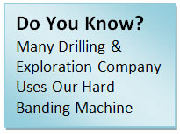
ARCRAFT PLASMA

Slide 4
FEATURES
Fully automatic operation through operator’s friendly control panel.
Single push button start for automatic weld cycle sequencing of Rotation, Welding, Oscillation, Step-over, Banding & Auto stop.
Degree overlap facility to avoid weld defect at stop of the weld.
Automatic Step-Over for programmable number of bands.
Unique feature of reverse overlap compensation for uniform appearance of start / stop of weld bands in single line.
Hollow spindle to accommodate all types of pipes.
Hollow Barrel True Chuck with hardened jaws.
Sealed roller / ball bearings for long service life.
Highly accurate, Smooth, Variable Width Torch Oscillator for excellent weld bead deposit.
Cross slides for easy positioning of torch before & during weld.
Heavy duty GMAW torch with long life consumables.
Supply input 380 - 415 VAC / 3-Phase / 50-60 Hz / 25 KVA.
ARCRAFT PLASMA

Slide 5
HOW IT WORKS

Slide 6
Hardbanding is the process of depositing hardfacing alloys onto drill pipe tool joints, collars, heavy weight drill pipe and other down hole components to protect both casing and drill string assets from abrasive wear.
Hardbanding is most commonly applied to the box end of drill pipe tool joints using a MIG welding process, bonding the hardbanding alloy with the parent steel of the drill pipe. There are, however, other hardbanding application methods that are occasionally used including laser and plasma arc processes.
The need for hardbanding arose decades ago when drilling contractors and operators wanted a way to protect casing and extend the life of costly drill string equipment from wear associated with rotational and axial forces while drilling and tripping in and out of a well.
Initially, tungsten-carbide particles were dropped into a mild-steel matrix, remaining the industry standard for many years.
ARCRAFT PLASMA

Slide 7
However, well owners soon realized that while the tool joint was well protected, the tungsten-carbide particles were often acting as a cutting tool against casing, causing extreme rates of wear and occasional total casing failure.
To address the critical need for a casing-friendly hardbanding product that could adequately protect tool joints and other down hole tools, Arcraft Plasma pioneered the casing-friendly hardbanding industry by utilizing an advanced alloy.
Since that time, the drilling industry has become increasingly complex, requiring the need for more advanced alloys that address a spectrum of hardbanding needs from high durability, to low casing wear to ease of use and compatibility with other hardbanding materials in the field.
Competitive hardbanding products must now be able to protect drilling and casing components, but also withstand extreme pressures and temperatures experienced in today’s critical wells.
Arcraft has invested heavily in R&D resources and aligned with technology partners who are able to provide superior alloy design methodology to quickly address the changing needs of the industry.
ARCRAFT PLASMA

Slide 8
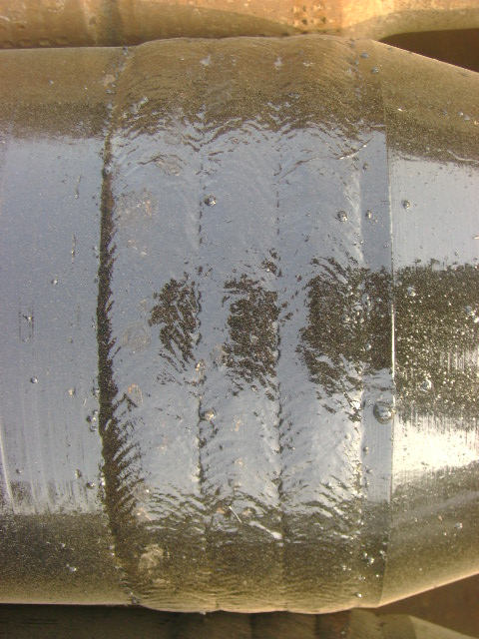
SAMPLE
ARCRAFT PLASMA

Slide 9
APPLICATIONS
OD Wear Protection On Drill Collars.
Drill Pipe.
Heavy Wall Drill Pipe.
Hard banding Of Pin And Box Tools Joints.
Center Upset Wear Pad.
Other Tools Used In Drilling Applications.
ARCRAFT PLASMA

Slide 10
SCOPE OF SUPPLY
Lathe, Torch Carriage, Oscillator, Manual Slide.
Welding Source.
MIG/MAG Welding Machine.
Wire Feeder, SAW Head.
Air Plasma Gouging for removal of weld over lay(Model ARC CUT 25i).
Power source
Hand Torch (Air cooled) & Earthing Clamp both with 7 meter Cable.
Air Filter with regulator.
Box spanner.
Induction Heater.
Consumables (100- MIG Tip 01.4mm, 100 -MIG Tip 1.6mm, 25-MIG Gas Diffuser, 50-MIG Front cap,2-MIG Liner,100-SAW Tip 2.0mm, 100-SAW Tip 2.4mm, 100-Gouging Electrode, 100-Gouging Nozzle, 25-Gouging Electrode Holder, 25-Gouging Contact Tube, 25-Gouging Front cap, 1-Wire feed Roller 1.2mm, 1-Wire feed Roller 1.6mm, 1-SAW Roller 2.0mm, 1-SAW Roller 2.4mm)
ARCRAFT PLASMA

Slide 11
THANK YOU ARCRAFT PLASMA EQUIPMENTS PVT. LTD. Address : 124, Diamond Industrial Estate, Ketkipada, Dahisar (East), Mumbai- 68. Ph : 0091-22-28965890/5745/3247. Fax: 00-91-22-28966418 . email : arcraftplasma@gmail.com Website : www.arcraftplasma.com

